Slide 1

Sub Advisor Questionnaire – SAQ
2011 Release
Presented by
AMAS L3 Team

Slide 2
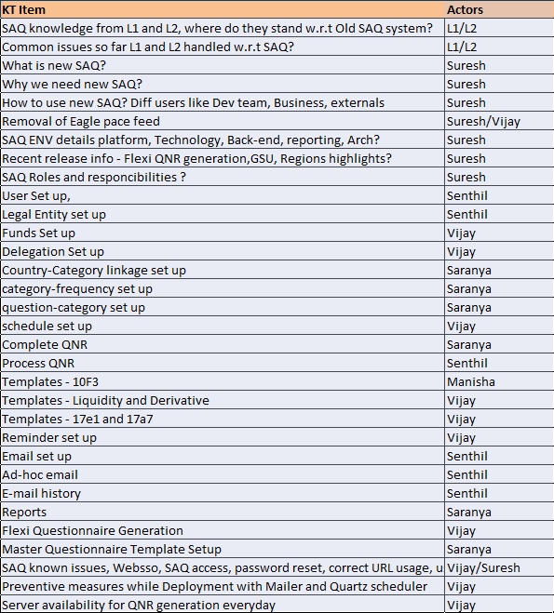
Agenda

Slide 3
SAQ Introduction/Scope
What is SAQ?
Who are typical users?
Why this is Used?
What is SAQ scope in terms of business?

Slide 4
SAQ Users
Business users
  Global Super User
  Regional Super User
  Delegator
  Delegatee
External Users
Application Team
PRD support team
Actuate Team

Slide 5
Removal of Eagle pace feed
In earlier version of SAQ Eagle pace feed is used to inject Delegation set up details to system
A database job which will induce various Delegation relationships to Database
This job also modifies existing relationships in the system
In new SAQ system we don’t have Eagle pace feed
All the Delegation relationships has to be mapped through SAQ UI only

Slide 6
SAQ Environment details

Slide 7
Release Overview
Flexible questionnaires will be generated at legal entity level which allow Global/Regional Super user to generate master Questionnaires based on the frequency and sub advisor type.
Convert external sub advisor contacts to delegation relationships as currently used for internal sub advisors. Also to have universal/common screen to maintain Affiliated and Unaffiliated Sub Advisor users.
Allow a Regional super /Global super user to classify/group questions by user identified categories. A country connection to categories is necessary to customize the sub advisors questionnaires.
Delegations list (or Active delegations relationship) displayed in delegation set up screen will be used as the new driver for generating the questionnaires for all cycles (Monthly/Quarterly/Annual), for both sub advisors types i.e. affiliated/internal and unaffiliated/external).
Additionally delegated funds & contacts will be included in the current delegations list for all externals.
Search for sub advisors questionnaire for all cycle (Monthly, Quarterly and Annual) in one screen.
Users will be able to see the Fund information and legal entities associated at any status of the questionnaires.
Allow Global Super users to view/assign schedule parameters such as Start month of a year, Start day of month and quarter periods for all delegator countries. And thus based on these values questionnaire generation process would be triggered.
Allow Super users to view/update Reminder days for Annual, Monthly and quarterly questionnaires. Based on the values set appropriate reminder mail will be sent to respective delegates for questionnaire completion.
Reports will reflect the From and To legal entities and Delegator/Delegatee countries
Added new fields to 10F3 Template. GSU can fill this template.

Slide 8
SAQ Responsibilities
User set up
Legal entity set up
Delegation set up
Fund set up
Category set up
Category Frequency set up
Country category set up
Schedule set up
Question set up
Flexible questionnaires generation
Flexible templates
Complete questionnaire
Process questionnaire
Reminder set up
Email set up
Reports

Slide 9
User setup
Accessible to GSU and RSU
The new process will get rid of the existing External and Internal user screens
The country names and legal entity names displayed in the add/modify user screens is based on login user role (GSU&RSU)
Inactivate user functionality
View legal entities functionality
Different roles- GSU, RSU , Delegator ,Delegatee , Sub advisor

Slide 10
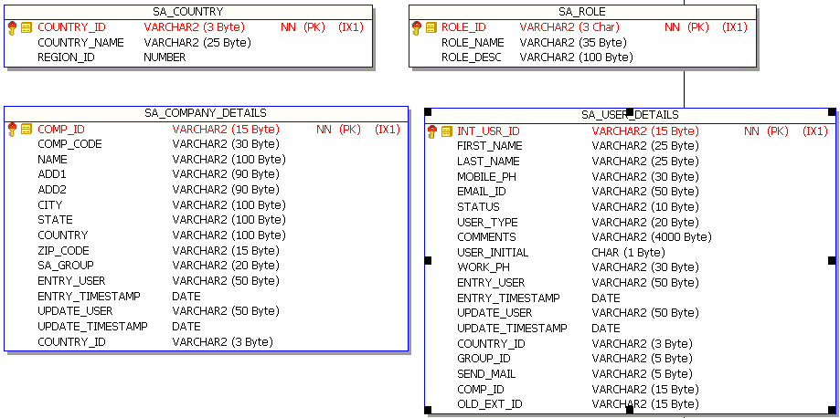
User setup (Contd.)
Accessible to GSU and RSU
The new process will get rid of the existing External and Internal user screens
The country names and legal entity names displayed in the add/modify user screens is based on login user role (GSU&RSU)
Inactivate user functionality
View legal entities functionality
Different roles- GSU, RSU , Delegator ,Delegatee , Sub advisor

Slide 11
Legal entity setup
Accessible to Global super user/Regional Super
To manage affiliated and unaffiliated legal entity details.
These legal entities will be used in ‘Delegation setup’ screen to create affiliated and unaffiliated delegation relationships.
Unaffiliated legal entities will also be used to map a user to legal entities for external sub advisor creation in ‘User setup’ menu.
If legal entity is part of delegation setup,
  Legal entity name alone can be modified
  Inactivation of legal entity is not possible
Search legal entity functionality

Slide 12
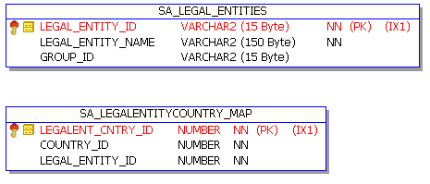
Legal entity setup (Contd.)

Slide 13
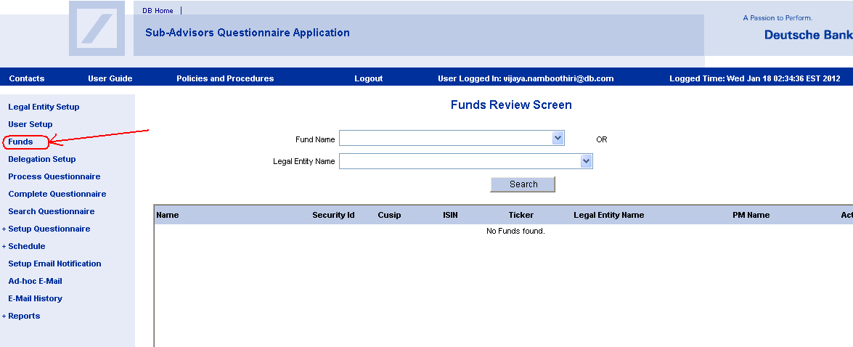
Funds

Slide 14
Funds (Contd.)
Accessibility – Only for Global Super user (GSU), Regional Super User (RSU)
Overview
  Funds Module is used to add/modify/inactivate funds for UNAFFILIATED Legal Entities
  In the new SAQ system,
    we added 2 new fields - Security Id (M) and ISIN (O)
    CUSIP, Ticker made as optional fields
    Sub-Advisor group is removed
    Sub-Advisor Name is renamed as Legal Entity and the corresponding dropdown will have all UNAFFILIATED legal entities
Usage
  Fund information will be used in delegation setup module for UNAFFILIATED relationships for mapping funds
  Criteria for display - Funds are only for UNAFFILIATED (To Legal Contracting Entity)
  In Reports >> Sub-Advisor By Fund Report
Pre-Requisites
  UNAFFILITED Legal Entity should have created before creating funds (Using Legal Entity Setup module)

Slide 15
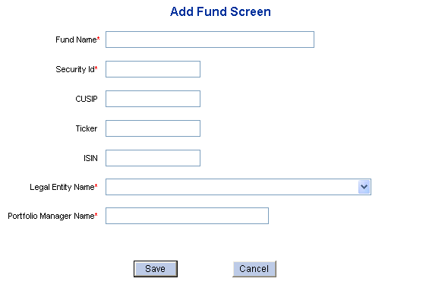
Funds (Contd.)
Notes:
In the new SAQ system,
we added 2 new fields - Security Id (M) and ISIN (O)
CUSIP, Ticker made as optional fields
Sub-Advisor group is removed
Sub-Advisor Name is renamed as Legal Entity and the corresponding dropdown will have all UNAFFILIATED legal entities

Slide 16
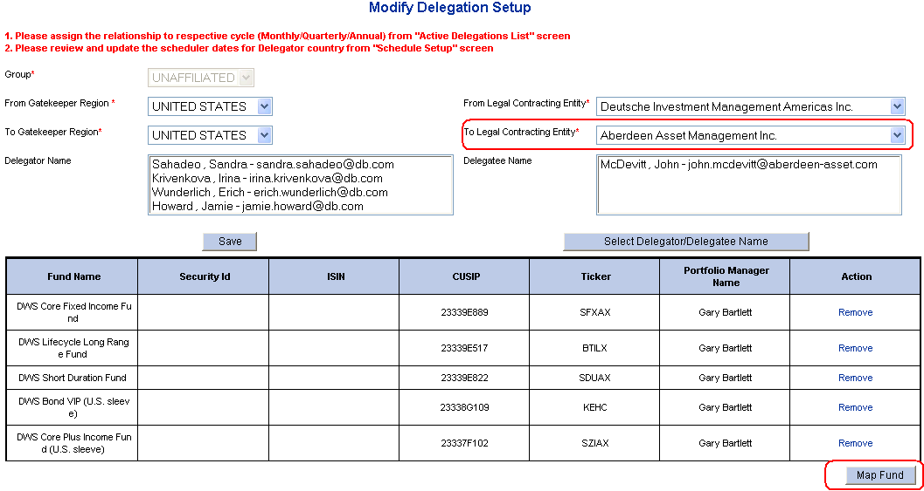
Funds (Contd.)
Notes:
Fund information will be used in delegation setup module for UNAFFILIATED relationships for mapping funds
Criteria for display - Funds are only for UNAFFILIATED (To Legal Contracting Entity)

Slide 17
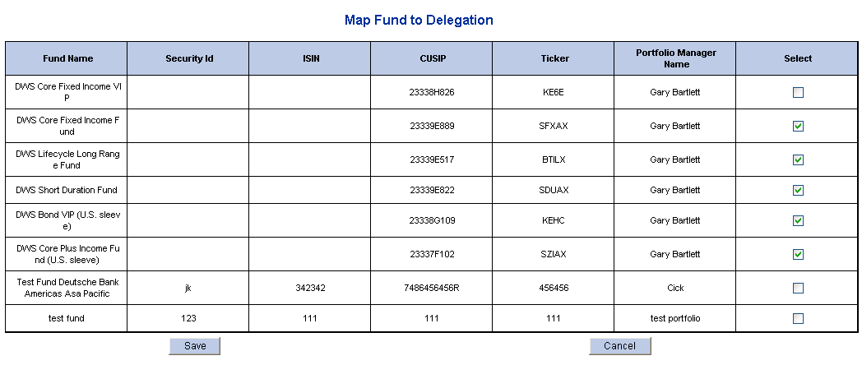
Funds (Contd.)
Notes:
Fund information will be used in delegation setup module for UNAFFILIATED relationships for mapping funds
Criteria for display - Funds are only for UNAFFILIATED (To Legal Contracting Entity)

Slide 18
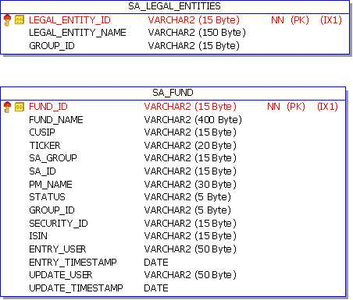
Funds (Contd.)

Slide 19
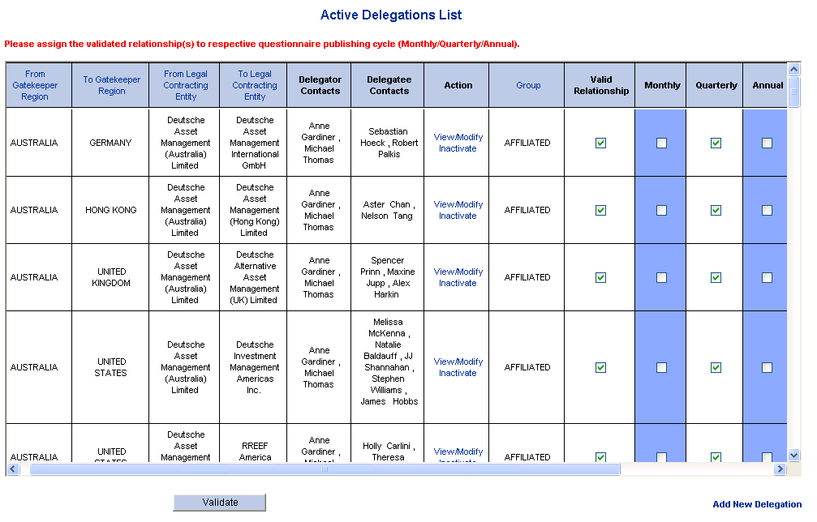
Delegation Setup

Slide 20
Delegation Setup (Contd.)
Accessibility – Global Super User (GSU), Regional Super User (RSU), Delegator, Delegatee. External Sub-advisor (delegatee) will not have access to this module.
  GSU : RW access to all relationships available
  RSU : RW access to Delegatee/Delegator relationships for all the countries falling in the logged-in user’s region
  Delegator/Delegatee : RO access to those relationships where logged in user is a delegator/delegatee contact
Overview
  Maintain (Validate) the AFFILIATED/UNAFFILIATED delegation relationships in the system
  Assigning to questionnaire generation cycle
  Adding Portfolios (for AFFILIATED) /Funds (for UNAFFILIATED) to relationship
Usage
  Questionnaires are sent out (generated) based on the validated relationships and their questionnaire generation cycle information
Pre-Requisites
  AFFILIATED/UNAFFILIATED legal entities – Legal Entity Setup
  Delegator/Delegator contacts (Optional) – User Setup

Slide 21
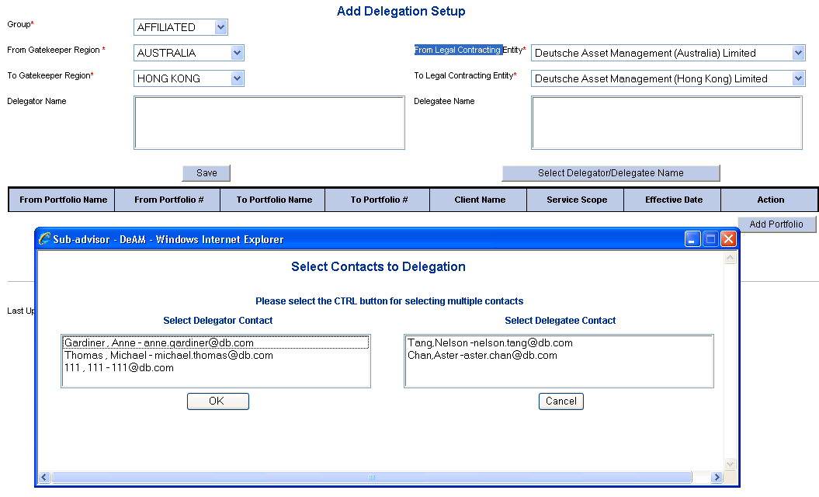
Delegation Setup (Contd.)

Slide 22
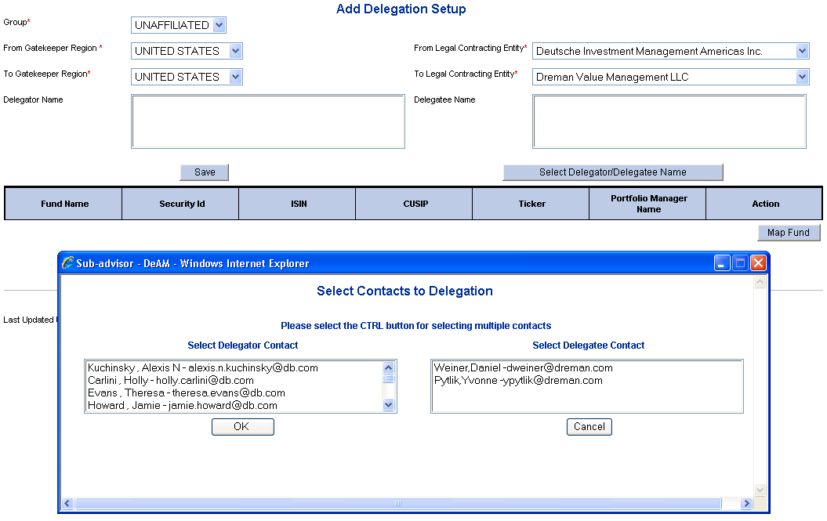
Delegation Setup (Contd.)

Slide 23
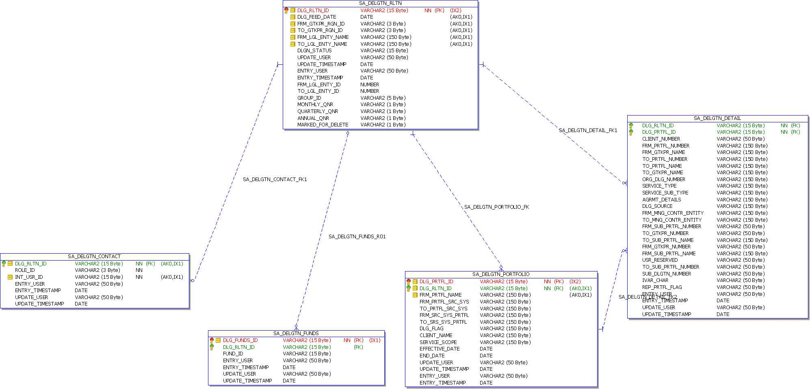
Delegation Setup (Contd.)

Slide 24


Slide 25


